Slide 1
Binary Network
胡超杰
2018.10.12

Slide 2
XNOR-Net:ImageNet Classiﬁcation Using Binary Convolutional Neural Networks(ECCV2016)
Bi-Real Net: Enhancing the Performance of 1-bit CNNs With Improved Representational Capability and Advanced Training Algorithm(ECCV2018)

Slide 3
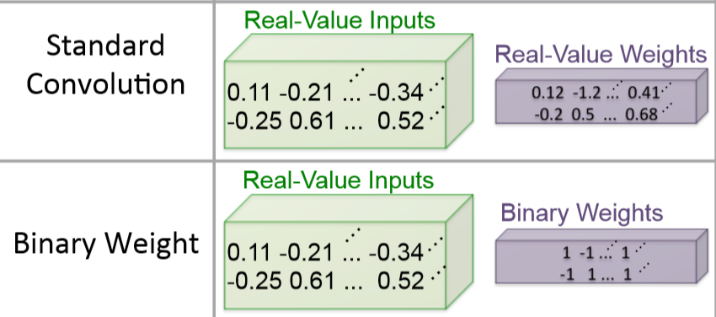

XNOR-Net
$𝔀=sign(w)$
前向传播用$𝔀$，权重更新用$w$
信息表达缺失？
$梯度下降如何处理sign？$

Slide 4
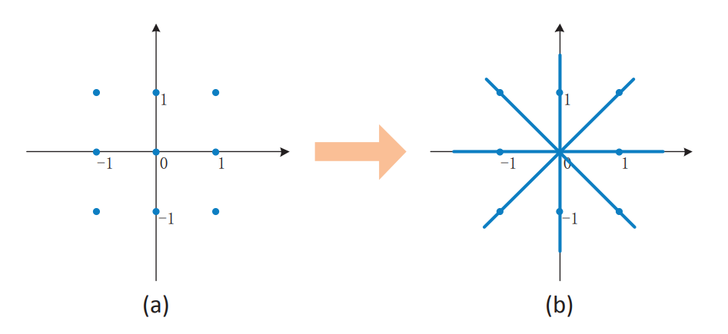

信息表达缺失？
$α𝔀$

Slide 5
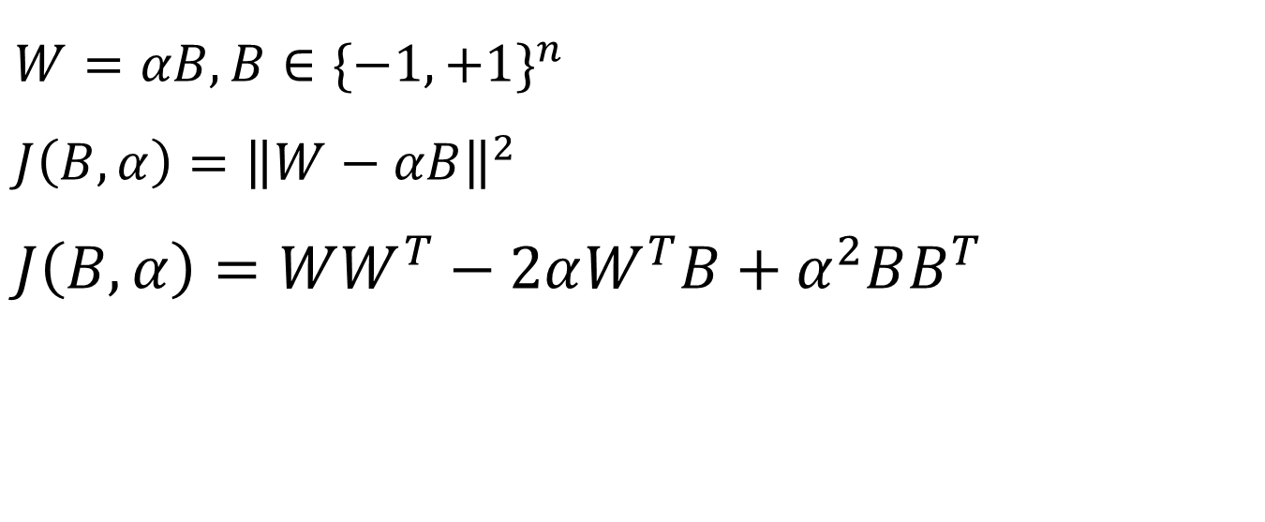
$$W=αB, B∈{\{−1,+1\}}^{n}$$
$$J\left(B,α\right)={\left\|W−αB\right\|}^{2}$$
$$J\left(B,α\right)=WW^{T}−2αW^{T}B+α^{2}BB^{T}$$

Slide 6

$$J\left(B,α\right)=WW^{T}−2αW^{T}B+α^{2}BB^{T}$$
当$α固定时$
$B^{∗}=argmax\left(W^{T}B\right) s.t.$ $B∈{\{−1,+1\}}^{n}$
$$B=sign(W)$$

Slide 7
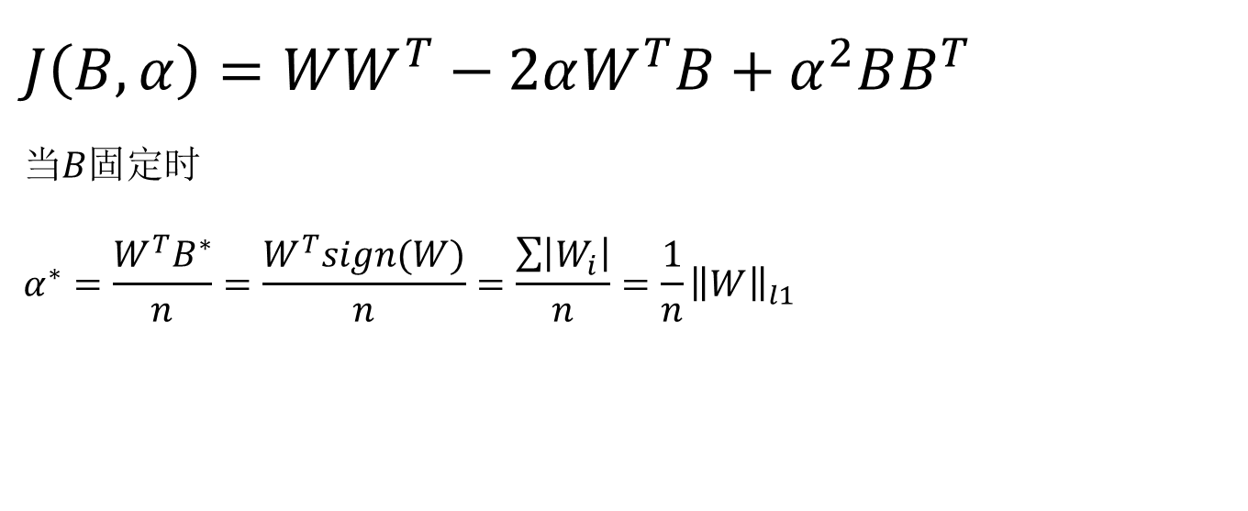
$$J\left(B,α\right)=WW^{T}−2αW^{T}B+α^{2}BB^{T}$$
当$B固定时$
$$α^{∗}=\frac{W^{T}B^{∗}}{n}=\frac{W^{T}sign(W)}{n}=\frac{\sum{\left|W_{i}\right|}}{n}=\frac{1}{n}{\left\|W\right\|}_{l1}$$

Slide 8
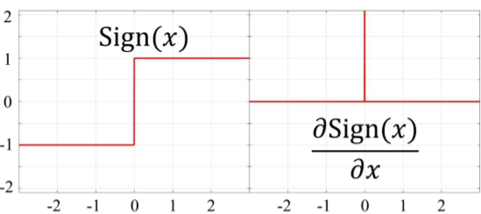
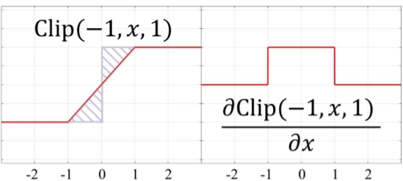

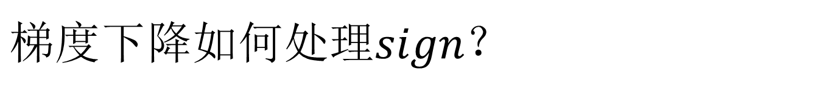
$$梯度下降如何处理sign？$$
$𝔀=sign\left(w\right)$
反向传播的梯度是针对于
$αw$的梯度
$$w^{t+1}=w^{t}−μGα$$

Slide 9
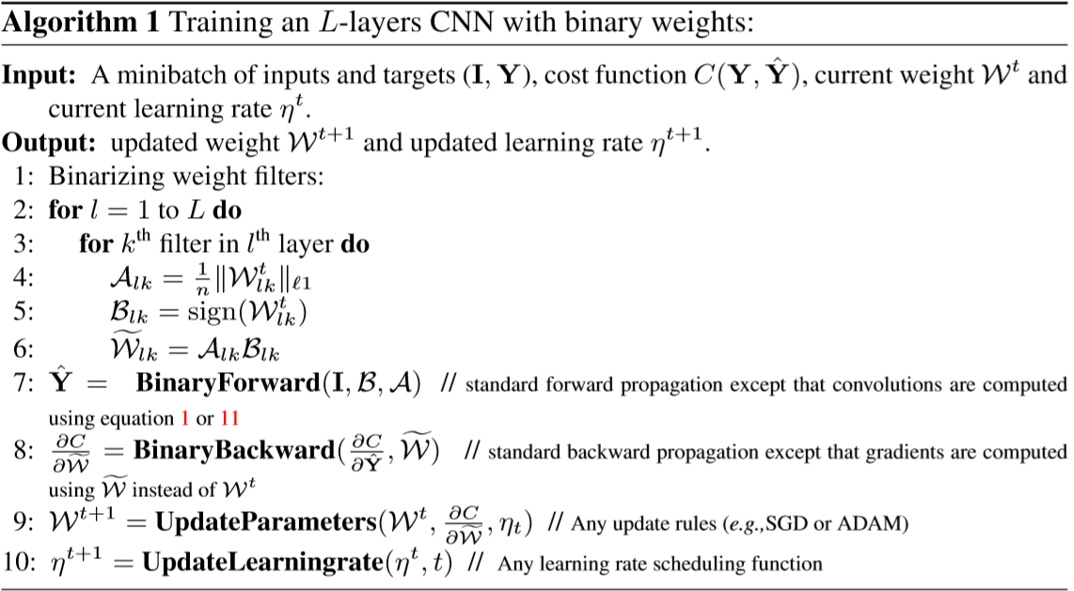
算法流程

Slide 10
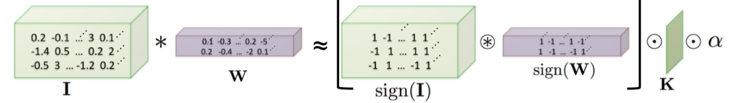

每一层的输入二值化
$𝓲=sign(I)$
$β𝓲$
$β=\frac{1}{n}{\left\|I\right\|}_{l1}$

Slide 11

激活函数$sign()$
$conv→batch norm→activ$

Slide 12
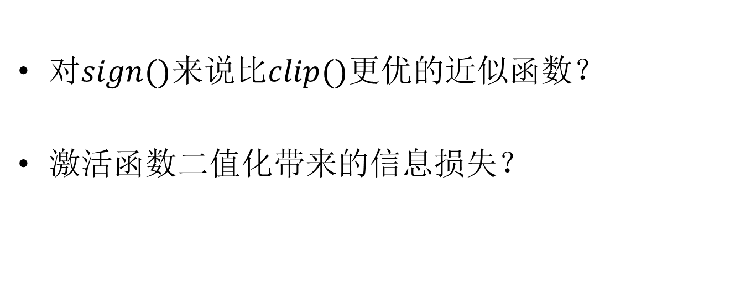
Bi-real Net
对$sign()$来说比$clip()$更优的近似函数？
激活函数二值化带来的信息损失？

Slide 13
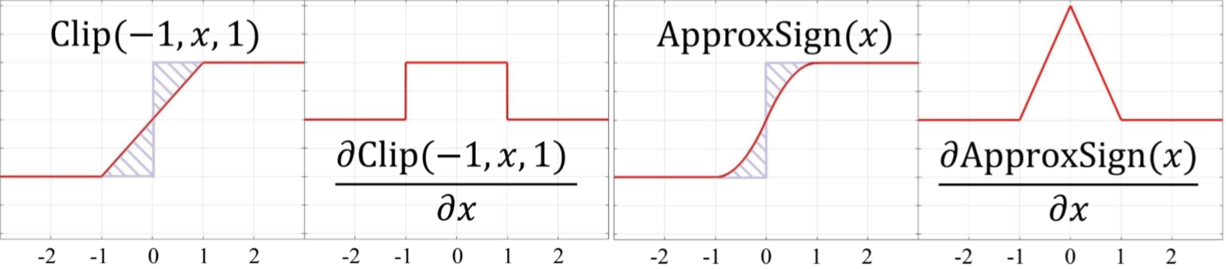

更优的近似函数
$$\frac{∂f(x)}{∂x}=\left\{\begin{aligned}2+2x −1≤x<0 \\ 2 −2x 0≤x<1 \\ 0 otherwise\end{aligned}\right.$$

Slide 14
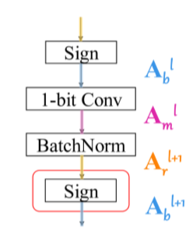
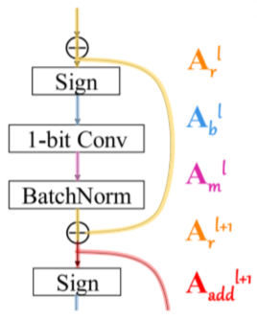
二值化带来的信息损失

Slide 15
可以尝试的方向
L0范数
Learning Sparse Neural Networks through L0 Regularization(ICLR2018)
混合整数规划
Extremely Low Bit Neural Network: Squeeze the Last Bit Out with ADMM(AAAI2018)

Slide 16
梯度量化
QSGD:Communication-EfﬁcientSGD via Gradient Quantization and Encoding(NIPS2017)
Error Compensated Quantized SGD and its Applications to Large-scale Distributed Optimization(ICML2018)

Slide 17
THANKS!

